Slide 1
Introduction to Python

Slide 2
What is python?
Python is an interpreted, high-level, general-purpose programming language.
Its language constructs and object-oriented approach aim to help programmers write clear, logical code for small and large-scale projects.

Slide 3
Getting started
Open terminal/command prompt
Type cd Desktop and press enter
This will change the working directory to Desktop
Type notepad a.py and press enter(Windows)
Type nano a.py and press enter(Linux)
This will create a python file and open it in notepad

Slide 4
Hello World
Enter the following and save the file
print(“Hello world”)
Go to command line and run the code
Windows -> a.py
Linux -> python a.py

Slide 5
Variable Types
The data stored in memory can be of many types.
Python has five standard data types −
Numbers
String
List
Tuple
Dictionary

Slide 6
Numbers
Python supports four different numerical types −
int (signed integers)
long (long integers, they can also be represented in octal and hexadecimal)
float (floating point real values)
complex (complex numbers)

Slide 7
Strings
Strings in Python are identified as a contiguous set of characters represented in the quotation marks.

Slide 8
String Example
str = 'Hello World!'
print (str) # Prints complete string
print (str[0]) # Prints first character of the string
print (str[2:5]) # Prints characters starting from 3rd to 5th
print str[2:] # Prints string starting from 3rd character
print (str * 2) # Prints string two times

Slide 9
Lists
Lists are the most versatile of Python's compound data types. A list contains items separated by commas and enclosed within square brackets ([]). To some extent, lists are similar to arrays in C. One difference between them is that all the items belonging to a list can be of different data type.

Slide 10
Lists Example
list = [ 'abcd', 786 , 2.23, 'john', 70.2 ]
tinylist = [123, 'john']
print (list) # Prints complete list
print (list[0]) # Prints first element of the list
print (list[1:3]) # Prints elements starting from 2nd till 3rd
print (list[2:]) # Prints elements starting from 3rd element
print (tinylist * 2) # Prints list two times
print (list + tinylist) # Prints concatenated lists

Slide 11
Tuples
A tuple is another sequence data type that is similar to the list. A tuple consists of a number of values separated by commas. Unlike lists, however, tuples are enclosed within parentheses.

Slide 12
Dictionary
Python's dictionaries are kind of hash table type.
Dictionaries are enclosed by curly braces ({ }) and values can be assigned and accessed using square braces ([]).

Slide 13
Dictionary Example
dict = {}
dict['one'] = "This is one"
dict[2] = "This is two"
tinydict = {'name': 'john','code':6734, 'dept': 'sales'}
print (dict['one']) # Prints value for 'one' key
print (dict[2]) # Prints value for 2 key
print (tinydict) # Prints complete dictionary
print (tinydict.keys()) # Prints all the keys
print (tinydict.values()) # Prints all the values

Slide 14
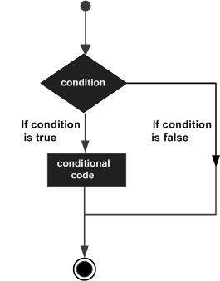
If Statement
if test expression:
statement(s)

Slide 15
Using If statement
var = 100
if ( var == 100 ) :
print "Value of expression is 100"
print "Good bye!"

Slide 16
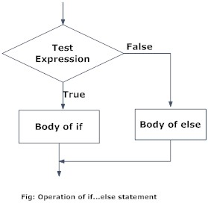
If Else
if test expression:
Body of if
else:
Body of else

Slide 17
If Else usage
num=3
if num >= 0:
print("Positive or Zero")
else:
print("Negative number")

Slide 18
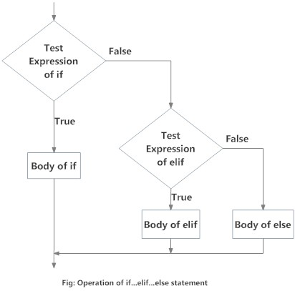
Elif
if test expression:
Body of if
elif test expression:
Body of elif
else:
Body of else

Slide 19
Elif example
num = 2.9
if num > 0:
print("Positive number")
elif num == 0:
print("Zero")
else: print("Negative number")

Slide 20
Nested if statements
We can have a if...elif...else statement inside another if...elif...else statement. This is called nesting

Slide 21
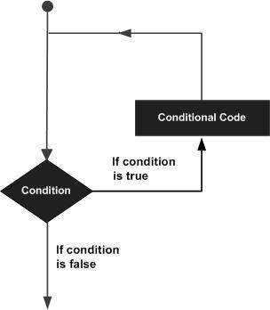
Loops
A loop is used when a part of a code has to be run repeatedly

Slide 22
Loops
The types of loops used are
for
while

Slide 23
For loop
for x in range(5):
print(“Hello World”)

Slide 24
While loop
count = 0
while count < 5:
print(count)
count += 1 # This is the same as count = count + 1

Slide 25
Functions
A function is a block of code which only runs when it is called.
You can pass data, known as parameters, into a function.
Example
def my_function():
print("Hello from a function")
my_function()

Slide 26
Using parameters in Functions
fruits = ["apple", "banana", "cherry"]
def my_function(food): for x in food: print(x)
my_function(fruits)

Slide 27
Returning Values
def my_function(x):
return 5 * x
print(my_function(3))
print(my_function(5))
print(my_function(9))

Slide 28
Robotic Operating System (ROS)
ROS is an open-source, meta-operating system for your robot.
It provides the services you would expect from an operating system, including hardware abstraction, low-level device control, implementation of commonly-used functionality, message-passing between processes, and package management.
It also provides tools and libraries for obtaining, building, writing, and running code across multiple computers.

Slide 29
THANK YOU

